Slide 1




Introducing Symfony
Composer, Bundles,
Symfony Framework
PHP MVC Frameworks
Veselin Malezanov
Technical Trainers
Software University
http://softuni.bg

Slide 2


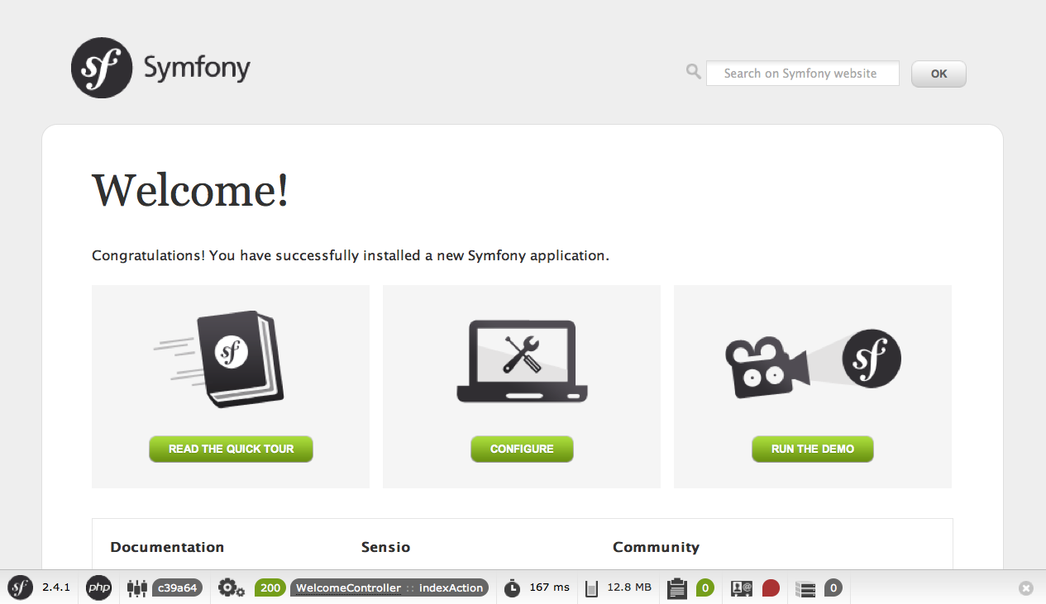
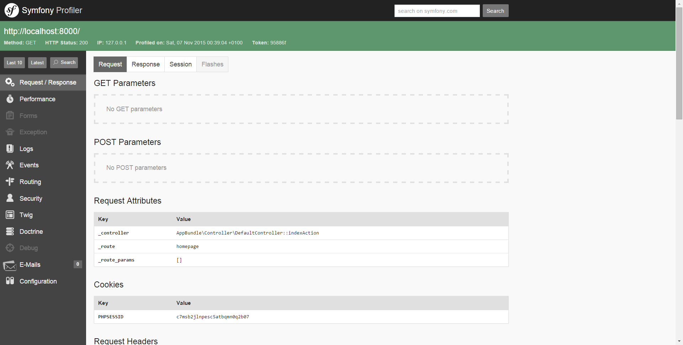
Table of Contents
Introducing Symfony
Install Symfony
Symfony Installer
Composer
Symfony Overview

Slide 3
Have a question?
#sli.do
#PHP-WEB

Slide 4
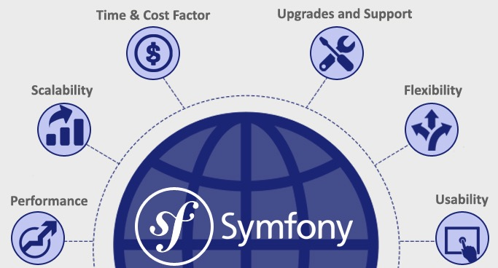

Introducing Symfony
Advantages of The Framework

Slide 5

Introducing Symfony
MVC Architecture
Scalability
Great Set of Components
Active community
Good documentation

Slide 6
Install & Configure Symfony
Symfony Installer & Composer

Slide 7
Symfony Installer
To install Symfony Installer on Windows execute:
php -r "readfile('https://symfony.com/installer');" > symfony
To install Symfony Installer on Linux and macOS execute:
sudo mkdir - p /usr/local/bin
sudo curl - LsS https://symfony.com/installer -o /usr/local/ bin/symfony
sudo chmod a+x /usr/local/bin/symfony

Slide 8
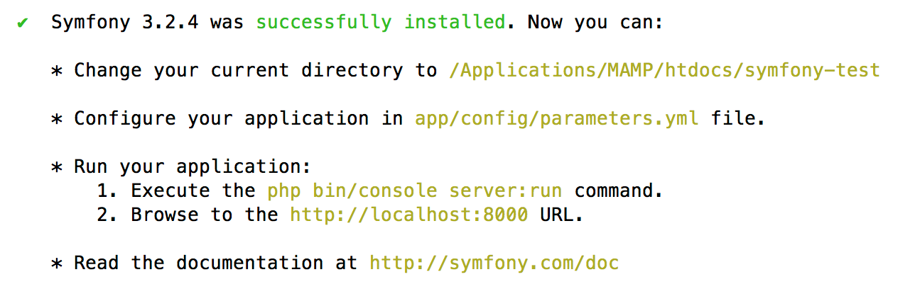
Symfony Installer
To install Symfony Framework execute:
symfony new my_project_name

Slide 9
Composer
To install Composer go to https://getcomposer.org/download/ and follow instructions.

Slide 10
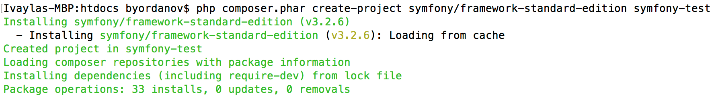
Composer
Install Symfony with Composer:
php composer.phar create-project symfony/framework-standard-edition my_project_name
php composer.phar create-project symfony/framework-standard-edition my_project_name “2.8.*"

Slide 11
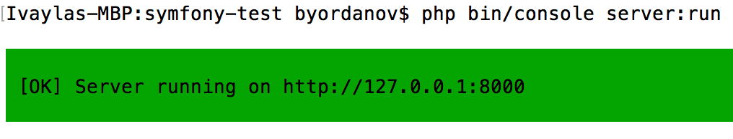
Run Symfony
Start the server
cd my_project_name/
php bin/console server:run

Slide 12

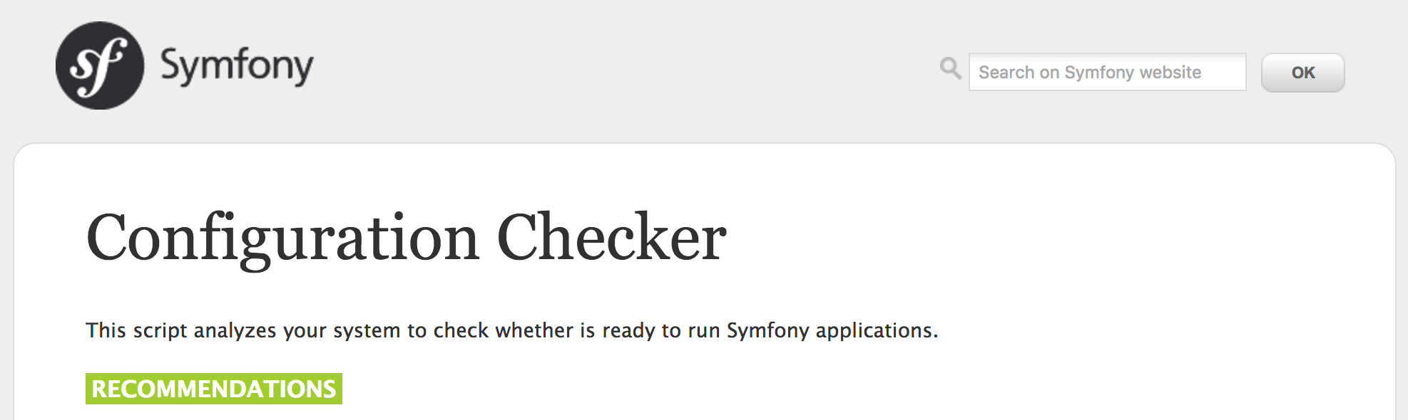
Run Symfony
To check configuration

Slide 13
Practise: Install Symfony
Live Exercise In Class (Lab)

Slide 14
Problem 1
Install Composer and/or Symfony Installer
Problem 2
Create new Symfony project with Composer or Symfony Installer

Slide 15
Symfony Overview
First Steps With The Framework

Slide 16
The Bundle System
What is a Bundle?
set of files within a directory designed to imlpement a single feature
each bundle has its own namespace
\<Vendor Name>\(<Namespace>\)*<Class Name>

Slide 17
The Bundle System
The bundle class name must follow five simple rules:
Use only alphanumeric characters and underscores;
Use a CamelCase name;
Use a descriptive and short name (no more than two words);
Prefix the name with the concatenation of the vendor (and optionally the category namespaces);
Suffix the name with Bundle.

Slide 18
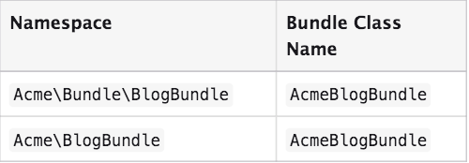
The Bundle System
Example of valid bundle names:

Slide 19
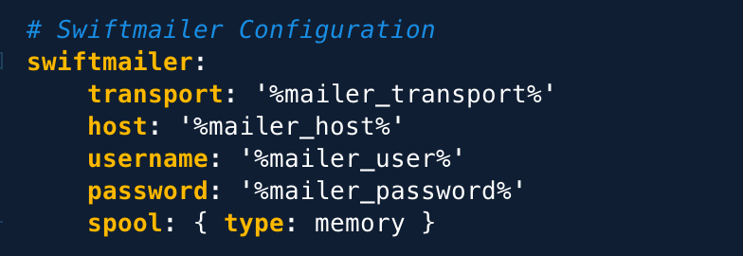
YAML - YAML Ain’t Markup Language!
YAML is:
human-readable data serialization language like json and xml, but easier to read
based on key: value
used for Symfony configuration

Slide 20
Directory Structure
Directory | Description
app/ | Application Kernel (AppKernel) and main configuration files in config/ directory
bin/ | Symfony console
src/ | the project’s code
tests/ | automatic(unit) tests

Slide 21
Directory Structure
Directory | Description
var/ | logs and cache files
vendor | third-party dependecies (bundles)
src/ | the project’s code
web/ | web root directory, application index

Slide 22
Symfony Project Overview
app/AppKernel.php
Is the most important file of our project
All bundles are registered/activated in AppKernel
class AppKernel extends Kernel {
public function registerBundles() {
$bundles = [
new Symfony\Bundle\FrameworkBundle\FrameworkBundle(), ];
//TO DO
}

Slide 23
Symfony Project Overview
app/AppKernel.php
AppKernel also provides configuration for different environments
class AppKernel extends Kernel {
public function registerBundles() {
//TO DO
if (in_array($this->getEnvironment(), ['dev', 'test'])) {
$bundles[] = new Symfony\Bundle\DebugBundle\DebugBundle();
}
}
}
Each environment should have its own config file suffixed with the name of the provided environment, e.g.: config_dev.yml
Each environment creates its own cache and log files in var/cache and var/log

Slide 24
Symfony Project Overview
app/config/config.yml
Application main config file for application settings
framework:
templating:
engines: [‘twig’]
imports:
- { resource: parameters.yml }
- { resource: security.yml }
- { resource: services.yml }
- { resource: "@AppBundle/Resources/config/services.yml" }

Slide 25
Symfony Project Overview
app/config/parameters.yml
Infrastructure-related configuration like database settings and mail service
parameters:
database_host: localhost
database_name: symfony
dabatase_user: root
database_pass:
custom_param: param_value

Slide 26
Symfony Project Overview
app/config/routing.yml
Contains mapping between controllers and routes
user_profile:
path: /user/profile
defaults: { _controller: AppBundle:User:profile }
admin_dashboard:
path: /admin/dashboard
defaults: { _controller: AppBundle:Admin:dashboard }

Slide 27
Symfony Project Overview
app/config/security.yml
Authentication and authorization (access control) settings. Settings for password encoding, login form, roles, role hierarchy
security:
encoders:
AppBundle\Entity\User:
algorithm: bcrypt
cost: 13
//TO-DO
access_control:
- { path: /admin, role: [ROLE_ADMIN] }
- { path: ^/login, roles: IS_AUTHENTICATED_ANONYMOUSLY }

Slide 28
Symfony Project Overview
app/config/services.yml
Configuration for different services and bundles
services:
app.twig_extension:
class: AppBundle\Twig\AppExtension
tags:
- { name: twig.extension }

Slide 29
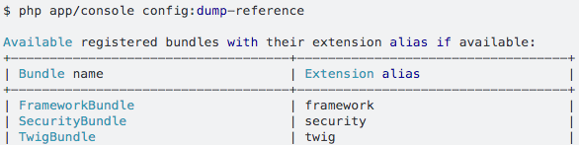
Symfony Project Overview
app/config/services.yml
Configuration for different services and bundles
Full project configuration:
php bin/console config:dump-reference
php bin/console config:dump-reference twig (view only twig configuration)

Slide 30
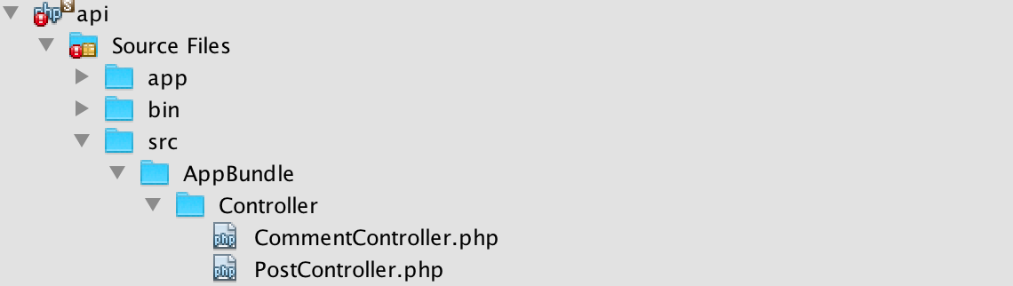
Symfony Project Overview
src/
Source folder of our bundles, eg.: AppBundle, AdminBundle, SoftUni/ForumBundle, SoftUni/BlogBundle
Controllers of the default Symfony bundle are placed in src/AppBundle/Controller.

Slide 31
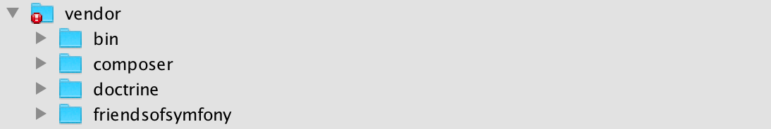
Symfony Project Overview
vendor/
Directory of all dependencies and external libraries used in our project.
Autoloading and depencencies are handled by Composer so we don’t need to do anything in this directory.

Slide 32
Symfony Project Overview
web/
The web root directory of our project.
All project assets such as JavaScript, css and images located here.
Access application with the build-in php server:
Access application for dev environment:

Slide 33
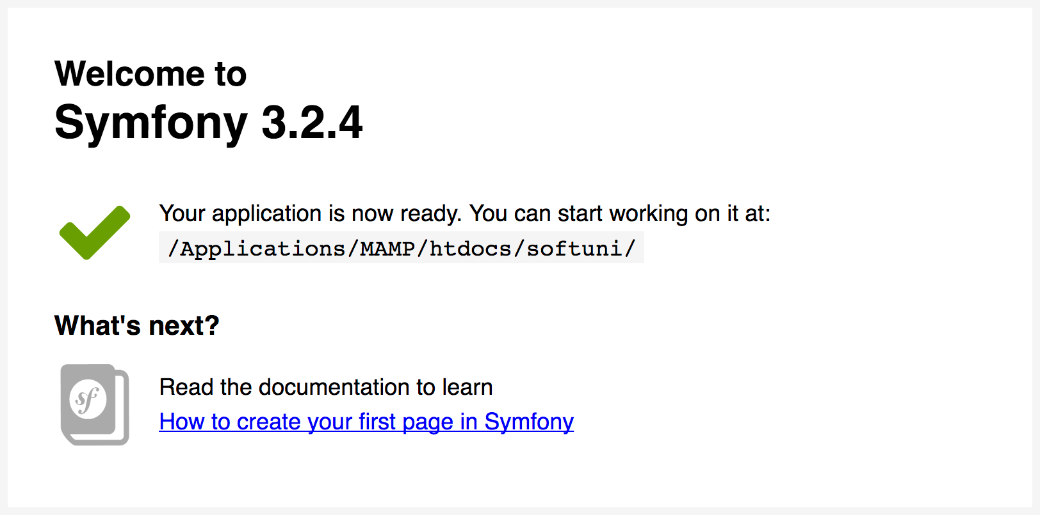
Welcome to Symfony

Slide 34

Summary
Install Composer and Symfony Installer
The Bundle system
YAML
Install Symfony and project structure

Slide 35
Introducing Symfony
https://softuni.bg/courses/

Slide 36
License
This course (slides, examples, demos, videos, homework, etc.) is licensed under the "Creative Commons Attribution-NonCommercial-ShareAlike 4.0 International" license

Slide 37



Trainings @ Software University (SoftUni)
Software University – High-Quality Education, Profession and Job for Software Developers
softuni.bg
Software University Foundation
softuni.org
Software University @ Facebook
facebook.com/SoftwareUniversity
Software University Forums
forum.softuni.bg

